Slide 1
Aashish Jain
Saint Paul, Minnesota
PhD: Monash University, Australia (Chemical Engineering)
Computational modeling of polymeric liquids
Postdoctoral associate: University of Minnesota (Chemical Engineering and Materials Science)
Simulation of DNA in nanochannels
Predicting the likelihood of flight cancellations
Amazon Alexa, Boston, MA
January 9th, 2018

Slide 2




PhD: Computational modeling of polymeric liquids
Applications:
3 publications
5 conferences
Won 3 minute thesis presentation competition
Couple of prestigious scholarships
Led to a new research direction

Slide 3
Postdoctoral work: Simulation of DNA in nanochannels
https://www.factinate.com/things/24-fascinating-facts-dna/
5 publications
3 conferences
Press release of one of the projects
Image courtesy of BioNano Genomics

Slide 4

Predicting the Likelihood of Flight Cancellations
Data Science Intensive Capstone Project, May 29th 2017 Cohort

Slide 5
Introduction
Total domestic flights in two years (2015 and 2016) in the US:
≅12 millions
Top 20 airports:
≅2.85 millions
Cancellation rate:
1.14% (≅32,600 flights)
Even though 1.14% is a small number, one rare event causes lot of troubles to passengers
What factors affect flight cancellation rate?
Can we predict the likelihood of a flight getting cancelled?

Slide 6





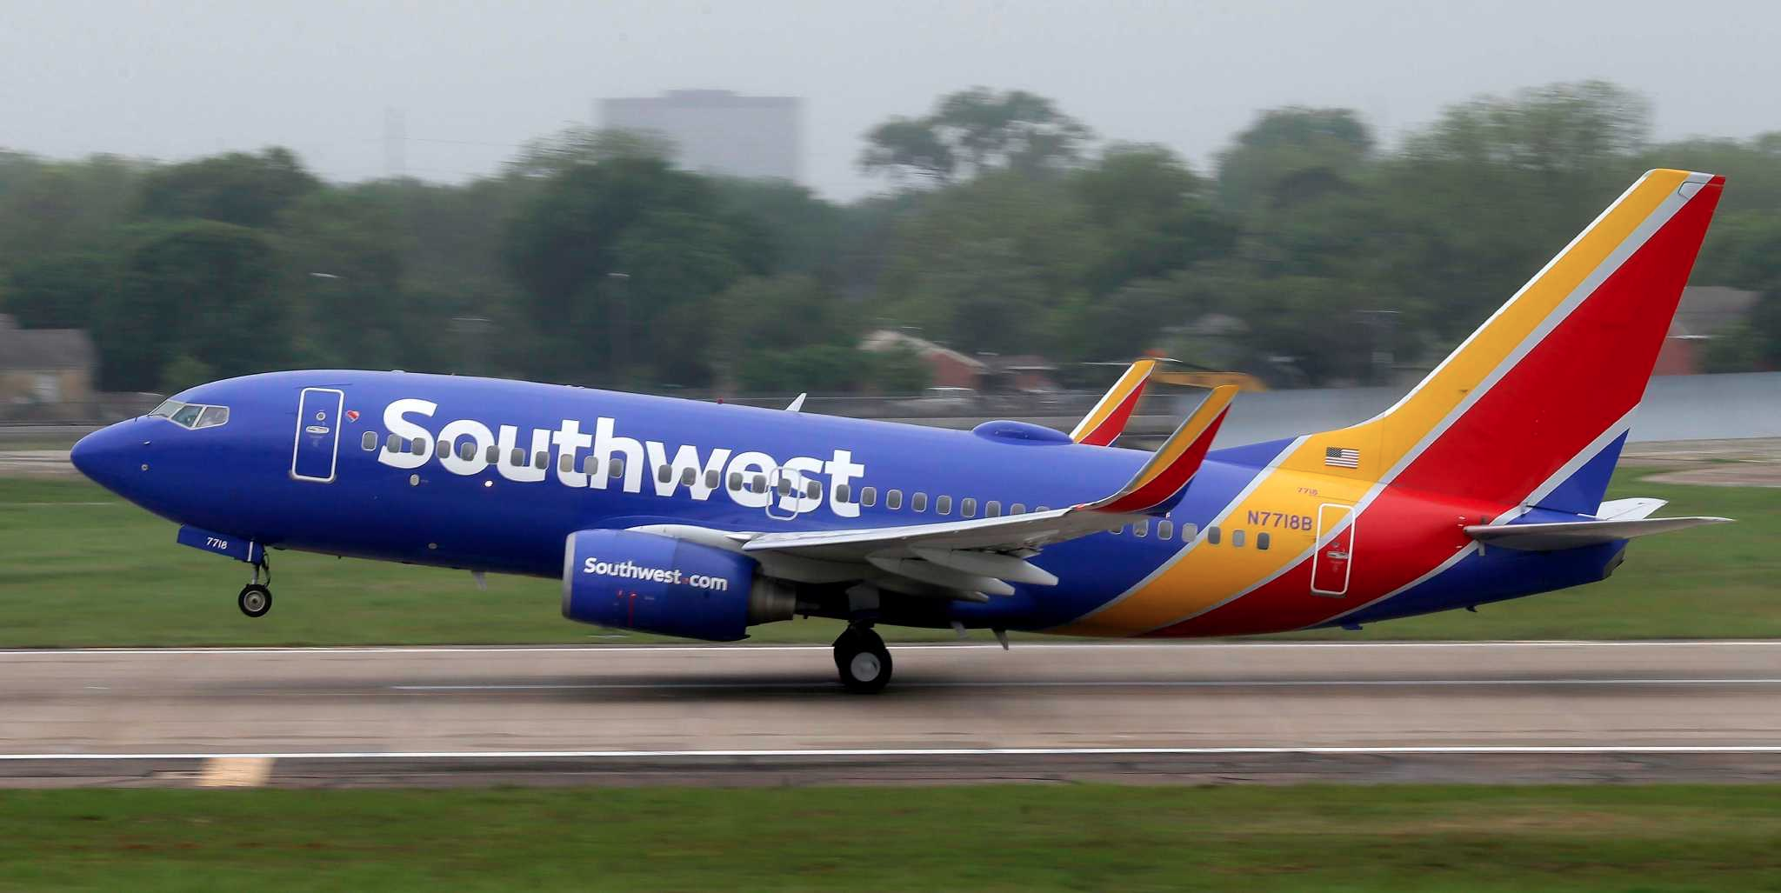



Who might care?
Travel Agencies
Airlines
Mobile Apps

Slide 7
What factors might affect flight cancellations?
Flight schedules: departure and arrival dates and times
Flight length: distance, flight times
Bureau of Transportation Statistics
Flight Data
Airline carriers
Airport locations: both origin and destination
Data Sources
Weather conditions: both origin and destination
Temperature, humidity, wind speed, pressure, etc..:both origin and destination
Weather Data
Wundergound.com API

Slide 8
Data Acquisition and Merging
Flight Data Specifics
Source: Bureau of Transportation Statistics
File format : csv
Number of columns: 66
Data can be downloaded for one month at a time
Concatenate files from all months into one grand csv file
Each record: a unique flight in terms of origin, dest., flight time window, airline
Weather Data Specifics
Source: Wunderground.com API
File format : XML (hourly data available)
Number of columns: 27
One API call: 24 hours data for a chosen airport (hourly frequency)
Concatenate files from all days into one file, for an airport
Each record: weather details for a chosen airport at a given hour
Merge them together using following keys:
Flight date at origin and destination
Origin and destination airport names
Scheduled departure and arrival times

Slide 9
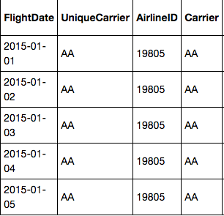
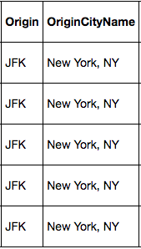
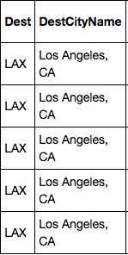
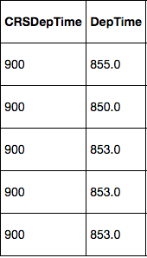
Engineering Flight Historical Performance Features From Flight Data
Steps for each flight:
Store the date of the flight in question: "thisDate”
Get Carrier, Origin, Destination, and Departure time
Filter the dataset based on 4 values found in step 2
Filter the filtered data further to get a subset of the data with only those dates that are "ndays" prior to "thisDate". We used ndays = 10, 20 and 30.
Use the ndays filtered dataset and perform aggregations such as count of cancelled flights, median of departure delays etc..
These aggregated results are then added as new fields/features (total: 27) to original dataset.

Slide 10
Data Summary
Data acquired for the period: January 2015 – December 2016
Flight and weather data for: Top 20 airports in the US (total airports: 327)
ATL: Atlanta, GA BOS: Boston, MA
BWI: Baltimore, MD CLT: Charlotte, NC
DEN: Denver, CO DFW: Dallas/Fort Worth, TX
DTW: Detroit, MI EWR: Newark, NJ
IAH: Houston, TX JFK: New York, NY
LAS: Las Vegas, NV LAX: Los Angeles, CA
LGA: New York, NY MCO: Orlando, FL
MSP: Minneapolis, MN ORD: Chicago, IL
PHX: Phoenix, AZ SEA: Seattle, WA
SFO: San Francisco, CA SLC: Salt Lake City, UT
Number of records: 2,857,139 (all airports: 12 million flights)
Number of fields: 67 (after data merging and cleaning)

Slide 11
Data Exploration
Flight schedules Airports Airlines Flight distance
Weather factors
Flight historical performances

Slide 12
Flight Cancellation Rate: Definition
Number of flights and cancellations on a daily basis
Cancellation rates on a daily basis
Here, a given scenario corresponds to a date. A scenario could be a weather condition, or a specific airline, or an airport, or a day of week, etc..

Slide 13
Flight schedules Airports Airlines Flight distance

Slide 14
Flight Schedules
Monthly cancellation rates
Weekly cancellation rates
Hourly cancellation rates

Slide 15
Airports and Airlines
ATL Atlanta, GA
BOS Boston, MA
BWI Baltimore, MD
CLT Charlotte, NC
DEN Denver, CO
DFW Dallas/Fort Worth, TX
DTW Detroit, MI
EWR Newark, NJ
IAH Houston, TX
JFK New York, NY
LAS Las Vegas, NV
LAX Los Angeles, CA
LGA New York, NY
MCO Orlando, FL
MSP Minneapolis, MN
ORD Chicago, IL
PHX Phoenix, AZ
SEA Seattle, WA
SFO San Francisco, CA
SLC Salt Lake City, UT
Airports
MQ - Envoy Air
EV - ExpressJet Airlines
US - US Airways
NK - Spirit Airlines
AA - American Airlines
B6 - Jetblue Airways
UA - United Airlines
OO - SkyWest Airlines
WN - Southwest Airlines
VX - Virgin America
DL - Delta Air Lines
F9 - Frontier Airlines
AS - Alaska Airlines
Airlines

Slide 16
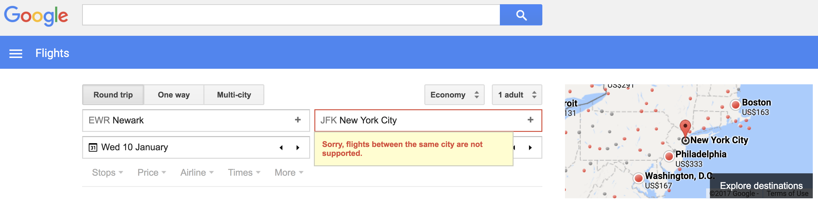
Flight Distance
EWR to JFK flight (21 miles) scheduled on April 20th, 2015 at 10:40 AM

Slide 17
Weather factors

Slide 18
Temperature, Humidity and Wind Speed
Temperature
Humidity
Wind speed

Slide 19
Wind Direction
0⁰ : North, 90⁰: East, 180⁰: South, 270⁰: West

Slide 20
Weather Conditions

Slide 21
Flight historical performances

Slide 22
Cancellation and Diversion History

Slide 23
Some Historical Indicators
Temporary flight: A flight which has history of no flights in lasy ndays
All cancelled: A flight which has history of 100% cancellations
All diverted: A flight which has history of 100% diversions

Slide 24
Departure and Arrival Delay History
Departure Delay
Arrival Delay

Slide 25
Predictive Modeling

Slide 26
Modeling Overview
Type: Supervised learning
Binary classification: 1 for cancelled and 0 for non-cancelled flights
Highly imbalanced data: 1.14% data tagged with class 1
Needs special attention
Tools: Python’s scikit learn and imblearn

Slide 27
Model Assumptions, Limitations and Disclaimers
Assume that all flights are independent, though there might be some time-correlations
Used only 20 airports and two years of data (2015-2016)
The model will behave poorly if we try to predict cancellations of flights that are scheduled too far in future mainly because we will have poor weather predictions
The flight data does not have Sun Country Airlines information in the current dataset

Slide 28
Stage I: Getting the best of each classifier
Data preparation and selection
Cross validation for model assessment and selection
One-hot-encoding of all categorical variables
Randomly select a small subset of the whole data (25%)
5-fold cross validation
At each iteration, perform the data pre-processing and train the classifier using data contained in 4-folds
Evaluate the model using the data contained in remaining one fold
Data pre-processing
Resampling to take care of imbalanced problem (only to training data)
Feature normalization
Use area under precision recall curve or PR AUC or average precision as the evaluation metric*
Pick the set of hyper parameters and the model that provide highest PR AUC
*J. Davis and M. Goadrich, The relationship between Precision-Recall and ROC curves, ICML '06 Proceedings of the 23rd international conference on Machine learning, Pages 233-240

Slide 29
Stage I: Comparing the best of each classifier
Estimators: 100
Features: sqrt(#features)
Resampling: Reweighting
Estimators: 100
Features: sqrt(#features)
Learning rate: 0.2
Resampling: Reweighting
How 100?
Estimators: 100
Features: sqrt(#features)
Resampling: Reweighting
Inverse of regularization strength: 10
Resampling: SMOTE (Synthetic Minority Oversampling Technique)
Resampling: Random undersampling
LR: Logistic Regression
GNB: Gaussian Naïve Bayes
RF: Random Forest
AB: AdaBoost
ET: Extremely Randomized Trees

Slide 30
Stage II: Training again on the bigger training dataset
Data preparation and selection
Cross validation for performance evaluation
One-hot-encoding of all categorical variables
Split the data into training (75%) and test (25%) datasets
5-fold cross validation
At each iteration, perform the data pre-processing and train the classifier using data contained in 4-folds
Calculate the PR AUC using the data contained in remaining one fold
Data pre-processing
Use the best resampling technique found in stage I to take care of imbalanced problem
Feature normalization

Slide 31
Final Results (training: 75% of data, testing: 25% of data)

Slide 32
Simplifying the best model (ET)
Number of features:
Feature importance
330
238
30
16
7
Top 50 features
238
52

Slide 33
An Example of Model Usage: Possible Recommendations

Slide 34
More Ideas to Improve Model in Future
Engineer more features related with airports such as number of runways, airport capacity, airport infrastructure, etc.
Extract more information about airlines such as their ratings, stock market performance etc., to get more features
Similar to flight historical performances, generate features with airport historical performances
Use social network and news media to extract sentiments about airlines and airport to get more features

Slide 35
Conclusions
All sources of datasets contributed to the predictive power of the model
Out of 5 supervised classification models, the Extremely Randomized Trees provided the best results: PR AUC = 0.4 and ROC AUC = 0.9
Out of 52 final variables, 12 correspond to flight data, 16 correspond to weather data and 24 correspond to historical information about airlines performance
With more ideas and by fixing various limitations and assumptions made in this work, the model can be improved in the future

Slide 36
Thank you!
Aashish Jain, PhD
Email: aajains@gmail.com
https://www.linkedin.com/in/aashishjain/
https://github.com/aajains/

